Slide 1
JavaScript
Lecture 1

Slide 2
Understanding Client/Server Architecture
Two-tier system
Client and server
Server or back end
Usually a database: client requests information
Client or front end
Responsible for user interface
Gathers information from user
Submits information to server
Receives, formats, presents results returned from the server

Slide 3
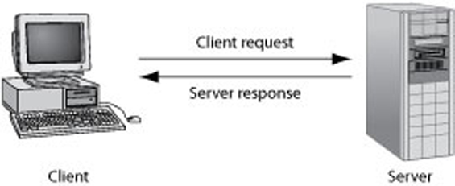
Understanding Client/Server Architecture (cont’d.)
The design of a two-tier client/server system
Web built on a two-tier client/server system
Requests and responses through which a Web browser and Web server communicate happen with HTTP

Slide 4
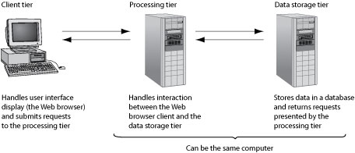
Understanding Client/Server Architecture (cont’d.)
The design of a three-tier client/server system
Three-tier, multitier, client/server system
Client tier
Processing tier
Data storage tier

Slide 5
What is JavaScript
JavaScript is Netscape's cross-platform, object-oriented scripting language.
JavaScript is a small, lightweight language; it is not useful as a standalone language, but is designed for easy embedding in other products and applications, such as web browsers. Inside a host environment, JavaScript can be connected to the objects of its environment to provide programmatic control over them.
Core JavaScript contains a core set of objects, such as Array, Date, and Math, and a core set of language elements such as operators, control structures, and statements.

Slide 6
What is JavaScript
Core JavaScript can be extended for a variety of purposes by supplementing it with additional objects; for example:
Client-side JavaScript extends the core language by supplying objects to control a browser and its Document Object Model (DOM).
For example, client-side extensions allow an application to place elements on an HTML form and respond to user events such as mouse clicks, form input, and page navigation.
Server-side JavaScript extends the core language by supplying objects relevant to running JavaScript on a server.
For example, server-side extensions allow an application to communicate with a relational database, provide continuity of information from one invocation to another of the application, or perform file manipulations on a server.
JavaScript lets you create applications that run over the Internet.
client applications run in a browser and
server applications run on a server.

Slide 7
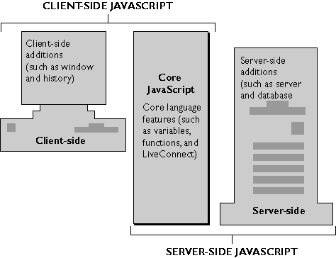
The components of JavaScript are illustrated in the following figure.

Slide 8
Core JavaScript
Client-side and server-side JavaScript have the following elements in common:
Keywords
Statement syntax and grammar
Rules for expressions, variables, and literals
Underlying object model (although client-side and server-side JavaScript have different sets of predefined objects)
Predefined objects and functions, such as such as Array, Date, and Math

Slide 9
Client-Side JavaScript
Web browsers can interpret client-side JavaScript statements embedded in an HTML page.
When the browser (or client) requests such a page, the server sends the full content of the document, including HTML and JavaScript statements, over the network to the client.
The browser reads the page from top to bottom, displaying the results of the HTML and executing JavaScript statements as they are encountered.

Slide 10
Client-side JavaScript statements embedded in an HTML page can respond to user events such as mouse clicks, form input, and page navigation.
For example, you can write a JavaScript function to verify that users enter valid information into a form requesting a telephone number or zip code.
Without any network transmission, the embedded JavaScript on the HTML page can check the entered data and display a dialog box if the user enters invalid data.

Slide 11
Server-Side JavaScript
On the server, you also embed JavaScript in HTML pages. The server-side statements can connect to relational databases from different vendors, share information across users of an application, access the file system on the server, or communicate with other applications through LiveConnect and Java.
HTML pages with server-side JavaScript can also include client-side JavaScript.
In contrast to pure client-side JavaScript pages, HTML pages that use server-side JavaScript are compiled into bytecode executable files.
These application executables are run by a web server that contains the JavaScript runtime engine.

Slide 12
Client side JavaScript
JavaScript is the most popular scripting language on the internet, and works in all major browsers, such as Internet Explorer, Firefox, Chrome, Opera, and Safari.
JavaScript is a programming language that lives inside your Web pages, and lets you control nearly every aspect of the pages.
JavaScript was designed to 'plug a gap' in the techniques available for creating web-pages.
HTML is relatively easy to learn, but it is static. It allows the use of links to load new pages, images, sounds, etc., but it provides very little support for any other type of interactivity.
To create dynamic material it was necessary to use either:
CGI (Common Gateway Interface) programs
Java applets
JavaScript
Allows Web page authors to develop interactive Web pages and sites
Client-side scripting language: runs on local browser
Scripting engine executes scripting language code

Slide 13
Client side JavaScript can be used to:
JavaScript can react to events - A JavaScript can be set to execute when something happens, like when a page has finished loading or when a user clicks on an HTML element
JavaScript can read and write HTML elements - A JavaScript can read and change the content of an HTML element as well as open and close new windows or frames
JavaScript can be used to validate data - A JavaScript can be used to validate form data before it is submitted to a server. This saves the server from extra processing
JavaScript can be used to detect the visitor's browser - A JavaScript can be used to detect the visitor's browser, and - depending on the browser - load another page specifically designed for that browser
JavaScript can be used to create cookies - JavaScript can be used to store and retrieve information on the visitor's computer
Build small but complete client side programs.
http://www.ryerson.ca/JavaScript/lectures/examples.html

Slide 14
Client-Side JavaScript
Limitations of JavaScript
Cannot be used outside the Web browser
No mechanism for creating a network connection or accessing a database
Cannot run system commands or execute programs on a client

Slide 15
Should You Use Client-Side or Server-Side Scripting?
General rule of thumb
Allow client to handle user interface processing and light processing (data validation)
Have the Web server perform intensive calculations and data storage
Important to perform as much processing as possible on the client

Slide 16
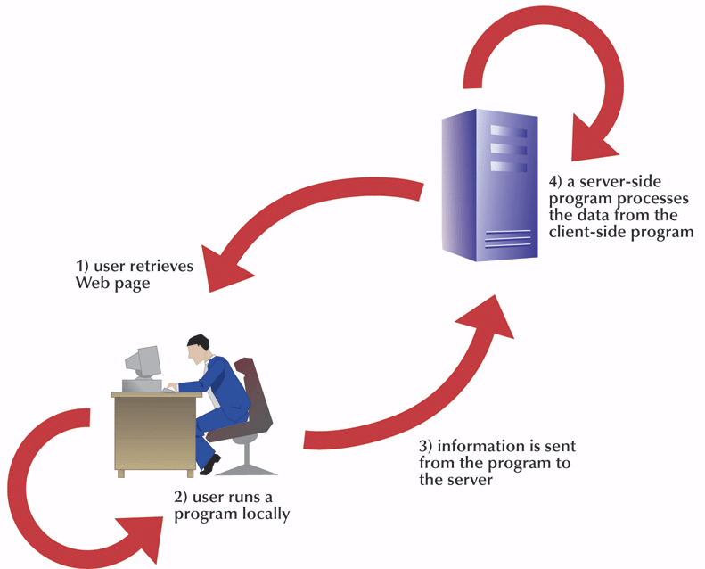
Combining Client-Side and Server-Side Programming

Slide 17
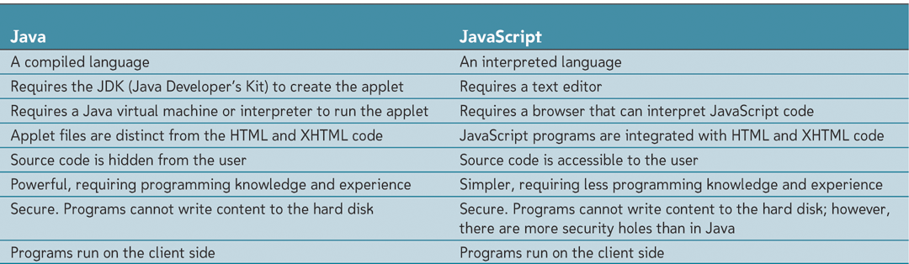
Java v’s JavaScript
Before we go any further please remember that Java is NOT JavaScript and visa versa

Slide 18
Putting JavaScript Into a Web Page
You put JavaScript into your pages between an opening<script> and </script> tag.
This tag takes the following attributes:
src: Optional . Specifies an external file to be executed
type: Optional. Specifies the language used in the <script> tag and a value of “text/javascript” is typically used.
defer: Optional. A Boolean value that tells the browser whether to wait to execute any code within the <script> element until after the browser loads the entire HTML document.
charset: Optional. The character encoding of the external code file specified by the src attribute.

Slide 19
Putting JavaScript Into a Web Page
There are 2 ways to use the <script> element:
embed JavaScript code directly into the page
<script type=“text/javascript”>
function inlineScript() {
var message = "Hello, World!";
alert(message);
}
inlineScript();
</script>
The browser stops loading the rest of the page when it encounters a <script> element; it loads the code and interprets it before processing the rest of the HTML page.
or use the src attribute to refer to an external file

Slide 20
Adding an external JavaScript file to the page incorporates the src attribute. (See the next slide)
Its possible to cut the code from the previous slide without the <script> tags, and paste it into another file.
Then, using the src attribute , the page can reference the external JavaScript file as shown:
<script type=“text/javascript” src=“sample.js”></script>
This <script> element references an external JavaScript file called sample.js.
Using the .js extension is a convention nearly all developers use.

Slide 21
Step-by-Step
Add an external JavaScript file to a web page using the following steps:
Open pspad and from the File | New File menu select JavaScript. Type the following code:
function inlineScript() {
var message = "Hello, World!";
alert(message);
}
inlineScript();
Save the file as lesson1.js
Open another file, this time a HTML5 file and type the following code:
……….
<title></title>
</head>
<body>
<script type="text/javascript" src="lesson1.js"> </script>
</body>
</html>

Slide 22
Save the file as lesson1.html and save it in the same location as the .js file.
Open the HTML file by double clicking on it and you should see an alert box saying “Hello World” when the browser loads the page.

Slide 23
Which to use ? Inline or External
Its ultimately up to you!
I would suggest using the external method for the following reasons:
Easier to maintain than inline scripts
External scripts are cached by the browser
How and where <script> elements are placed in the page do matter!

Slide 24
Tag Placement
The <script> element is one of the few elements that can go almost anywhere in an HTML page:
The <head>
………………..
<title>Sample Page </title>
<script type=“text/javascript” src=“sample.js”></script>
</head>
<body>
</body>
</html>
The <body>
……………….
<title>Sample Page </title>
</head>
<body>
<script type=“text/javascript” src=“sample.js”></script>
</body>
</html>

Slide 25
JavaScript Syntax & Variables
JavaScript is case sensitive
JavaScript is a loosely typed language
A variable can contain a text value at one time, and a number value at another
The following code shows a variable declaration statement:
var myVariable;
The variable in the above declaration doesn’t contain any data. It has been declared but has not been initialised or assigned a value
Use the assignment operator (=) to assign a value to the variable
var myVariable;
myVariable=“some text”;
or
var myVariable =“some text”;
When assigning a literal string value to a variable
Enclose text in quotation marks
When assigning a numeric value to a variable
Do not enclose number in quotation marks (or JavaScript will treat it as a string)
Can assign the value of one variable to another

Slide 26
JavaScript Variables
As with algebra, JavaScript variables are used to hold values or expressions.
A variable can have a short name, like x, or a more descriptive name, like carname.
Rules for JavaScript variable names:
Variable names are case sensitive (y and Y are two different variables)
Cannot be the same as a keyword or a reserved word
Variable names must begin with a letter or the underscore character
All other characters can be letters, whole numbers, underscores or dollar sign
You cannot include spaces in the name
Note: Because JavaScript is case-sensitive, variable names are case-sensitive.

Slide 27
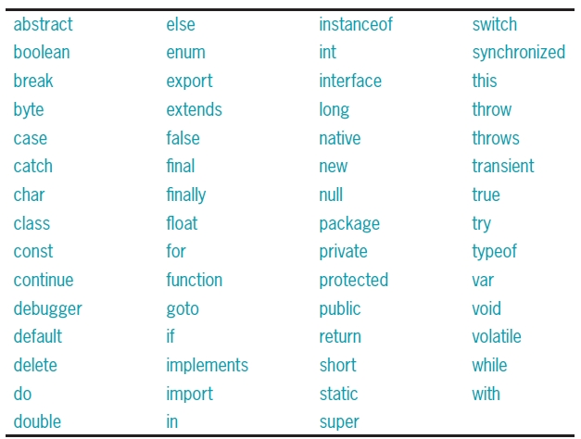
JavaScript Variable & Reserved Words (keywords)

Slide 28
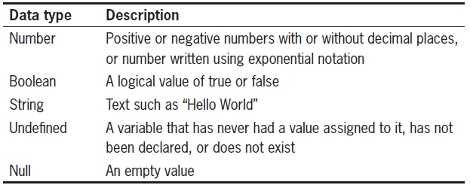
Working with Data Types
Data type
Specific information category a variable contains
Primitive types
Data types assigned a single value

Slide 29
Working with Data Types (cont’d.)
The null value: data type and a value
Can be assigned to a variable
Indicates no usable value
Use: ensure a variable does not contain any data
Undefined variable
Never had a value assigned to it, has not been declared, or does not exist
Indicates variable never assigned a value: not even null
Use: determine if a value being used by another part of a script

Slide 30
Understanding JavaScript Objects
Object
Programming code and data
Treated as an individual unit or component
Procedures
Individual statements used in a computer program grouped into logical units
Used to perform specific tasks
Methods
Procedures associated with an object

Slide 31
Understanding JavaScript Objects (cont’d.)
Property
Piece of data associated with an object
Assign value to a property using an equal sign
Argument
Information that must be provided to a method
Passing arguments
Providing an argument for a method

Slide 32
Using the write() and writeln() Methods
Document object
Represents content of a browser’s window
Create new Web page text with the write() method or the writeln() method of the Document object
Both methods require a text string as an argument
Text contained within double or single quotation marks
writeln() method adds a line break after the line of text

Slide 33
The document object is one of the most important objects of JavaScript.
document.write("Hi there.");
In this code,
document is the object.
write is the method of this object.
<body>
<script type="text/javascript">
document.write("<em>Hi there.</em>");
</script>
</body>
</html>

Slide 34
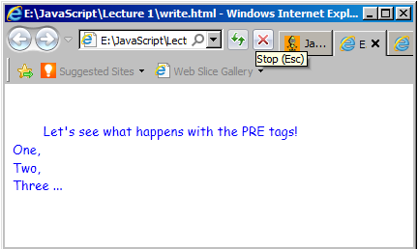
write() v’s writeln()
<pre style="color:blue; font-family:comic sans ms">
<script type="text/javascript">
document.write("\tLet\'s see what happens with the PRE tags!\n"); document.writeln("One,"); document.writeln("Two,"); document.write("Three "); document.write("...");
</script>
</pre>

Slide 35
Displaying variables: print a variable
Displaying variables: print a variable
Pass variable name to document.write() or document.writeln()method
Do not enclose it in quotation marks

Slide 36
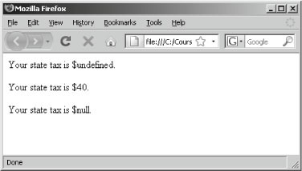
Working with Data Types (cont’d.)
var stateTax;
document.write("<p>Your state tax is $"+ stateTax + ".</p>");
stateTax = 40;
document.write("<p>Your state tax is $"+ stateTax + ".</p>");
stateTax = null;
document.write("<p>Your state tax is $“ + stateTax + ".</p>");
Variable assigned values of “undefined” and “null”

Slide 37
Working with Data Types (cont’d.)
JavaScript interpreter automatically determines data type stored in a variable
Examples:
diffTypes = "Hello World"; // String
diffTypes = 8; // Integer number
diffTypes = 5.367; // Floating-point number
diffTypes = true; // Boolean
diffTypes = null; // null

Slide 38
Understanding Numeric Data Types
JavaScript supports two numeric data types
Integers and floating-point numbers
Integer
Positive or negative number with no decimal places
Floating-point number
Number containing decimal places or written in exponential notation

Slide 39
Using Boolean Values
Logical value of true or false
Used for decision making
Which parts of a program should execute
Used for comparing data
JavaScript programming Boolean values
The words true and false
JavaScript converts true and false values to the integers one and zero when necessary

Slide 40
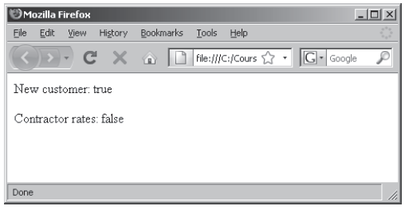
Using Boolean Values (cont’d.)
var newCustomer = true;
var contractorRates = false;
document.write("<p>New customer: "+ newCustomer + "</p>");
document.write("<p>Contractor rates:"+ contractorRates + "</p>");
Boolean values

Slide 41
Working with Strings
Text string
Contains zero or more characters
Surrounded by double or single quotation marks
Can be used as literal values or assigned to a variable
Empty string
Zero-length string value
Valid for literal strings
Not considered to be null or undefined

Slide 42
Working with Strings (cont’d.)
To include a quoted string within a literal string surrounded by double quotation marks
Surround the quoted string with single quotation marks
To include a quoted string within a literal string surrounded by single quotation marks
Surround the quoted string with double quotation marks
String must begin and end with the same type of quotation marks

Slide 43
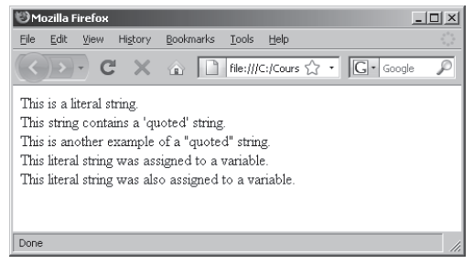
Working with Strings (cont’d.)
String examples in a Web browser

Slide 44
Working with Strings (cont’d.)
String operators
Concatenation operator (+): combines two strings
var destination = "Honolulu";
var location = "Hawaii";
destination = destination + " is in " + location;
Compound assignment operator (+=): combines two strings
var destination = "Honolulu";
destination += " is in Hawaii";
Plus sign
Concatenation operator and addition operator

Slide 45
Working with Strings (cont’d.)
Escape characters and sequences
Escape character
Tells the compiler or interpreter that the character that follows has a special purpose
In JavaScript, escape character is backslash (\)
Escape sequence
Escape character combined with other characters
Most escape sequences carry out special functions

Slide 46
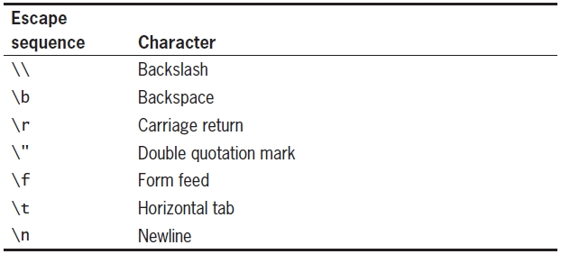
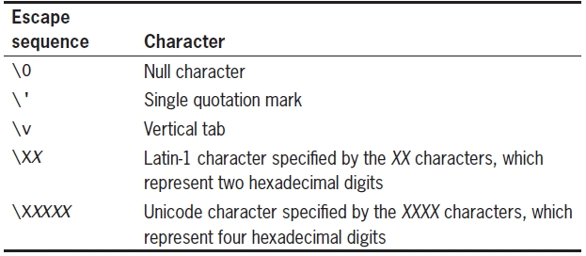
Working with Strings (cont’d.)

Slide 47
Using Operators to Build Expressions
JavaScript operator types

Slide 48
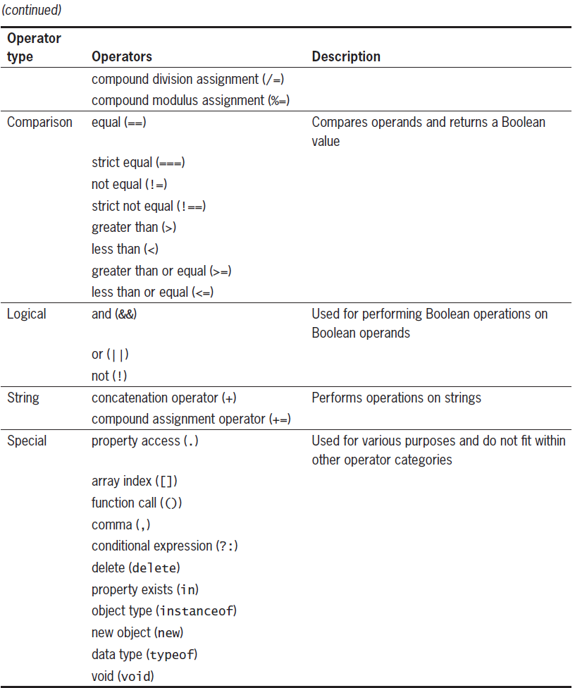
Using Operators to Build Expressions (cont’d.)
JavaScript operator types

Slide 49
Arithmetic Operators
Perform mathematical calculations
Addition, subtraction, multiplication, division
Returns the modulus of a calculation
Arithmetic binary operators

Slide 50
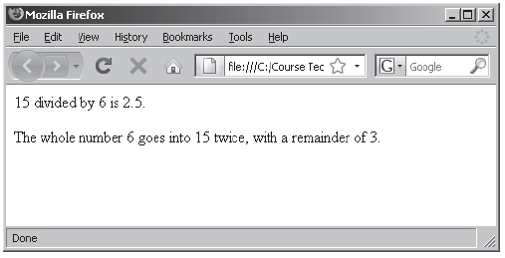
Arithmetic Operators (cont’d.)
Division and modulus expressions

Slide 51
Arithmetic Operators (cont’d.)
Prefix operator
Placed before a variable
Postfix operator
Placed after a variable
Arithmetic unary operators

Slide 52
Arithmetic Operators (cont’d.)
Arithmetic unary operators
Performed on a single variable using unary operators
Increment (++) unary operator: used as prefix operators
Prefix operator placed before a variable
Increment (++) unary operator: used as postfix operator
Postfix operator placed after a variable
Example: ++count; and count++;
Both increase the count variable by one, but return different values

Slide 53
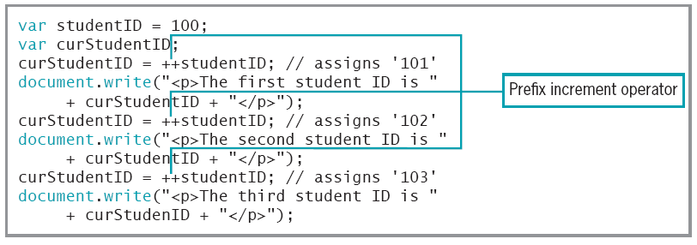
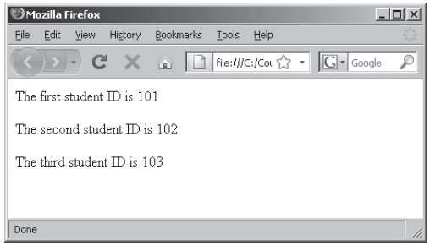
Arithmetic Operators (cont’d.)
Script that uses the prefix increment operator

Slide 54
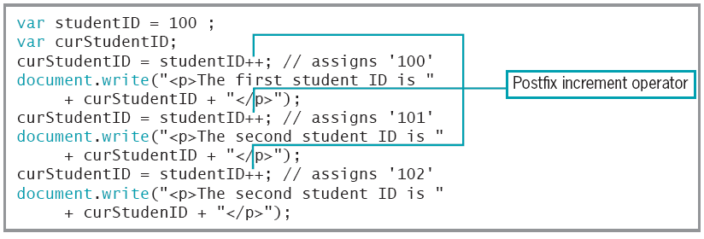
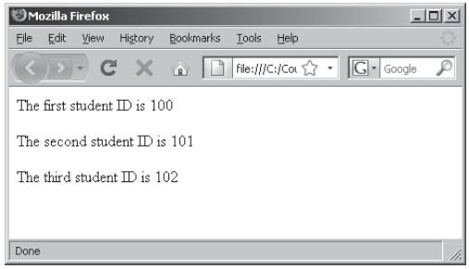
Arithmetic Operators (cont’d.)
Script that uses a postfix increment operator

Slide 55
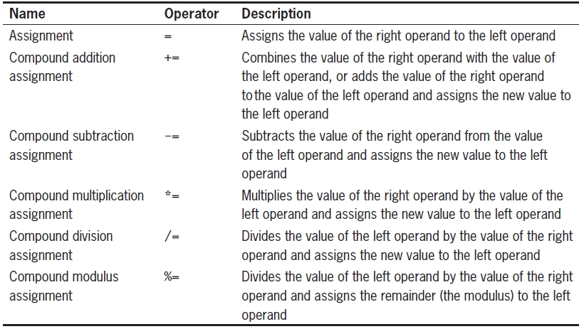
Assignment Operators
Used for assigning a value to a variable

Slide 56
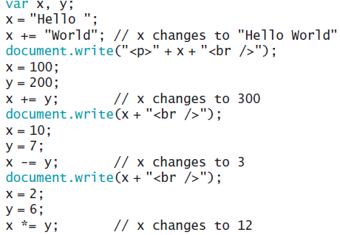
Assignment Operators (cont’d.)
+= compound addition assignment operator
Used to combine two strings and to add numbers
Examples:

Slide 57
Assignment Operators (cont’d.)
Examples: (cont’d.)

Slide 58
Comparison and Conditional Operators
Comparison operators
Compare two operands
i.e. determine if one numeric value is greater than another
Boolean value of true or false returned after compare
Operands of comparison operators
Two numeric values: compared numerically
Two nonnumeric values: compared in alphabetical order
Number and a string: convert string value to a number
If conversion fails: value of false returned

Slide 59
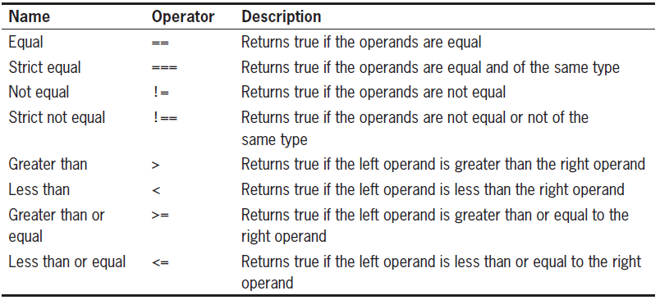
Comparison and Conditional Operators (cont’d.)

Slide 60
Comparison and Conditional Operators (cont’d.)
Conditional operator
Executes one of two expressions based on conditional expression results
Syntax
conditional expression ? expression1: expression2;
If conditional expression evaluates to true:
Then expression1 executes
If the conditional expression evaluates to false:
Then expression2 executes

Slide 61
Comparison and Conditional Operators (cont’d.)
Example of conditional operator:
var intVariable = 150;
var result;
(intVariable > 100) ? result =
"intVariable is greater than 100" : result =
"intVariable is less than or equal to 100";
document.write(result);

Slide 62
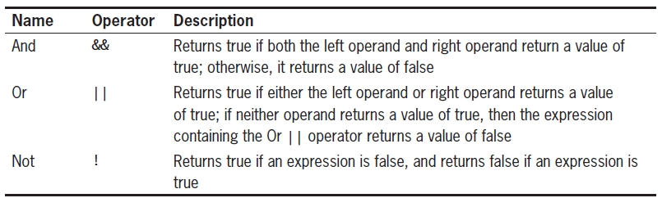
Logical Operators
Compare two Boolean operands for equality

Slide 63
Understanding Operator Precedence
Operator precedence
Order in which operations in an expression evaluate
Associativity
Order in which operators of equal precedence execute
Left to right associativity
Right to left associativity
See word document

Slide 64
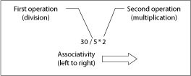
Understanding Operator Precedence (cont’d.)
Evaluating associativity
Example: multiplication and division operators
Associativity of left to right
Conceptual illustration of left to right associativity

Slide 65
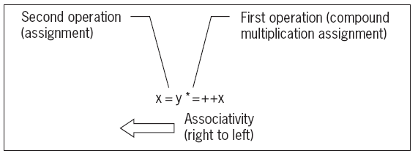
Understanding Operator Precedence (cont’d.)
Evaluating associativity (cont’d.)
Example: Assignment operator and compound assignment operators
Associativity of right to left
x = y *= ++x
var x = 3;
var y = 2;
x = y *= ++x;
Conceptual illustration of right to left associativity

Slide 66
JavaScript Functions and Events
JavaScripts in an HTML page will be executed when the page loads. This is not always what we want
Sometimes we want to execute a JavaScript when an event occurs, such as when a user clicks a button. When this is the case we can put the script inside a function
Events are normally used in combination with functions (like calling a function when an event occurs)
You will learn more about JavaScript functions and events

Slide 67
Debugging Your JavaScript Programs
Load-time error
Occurs when script is first loaded by JavaScript interpreter
Run-time error
Occurs after script has been successfully loaded and is being executed
Logical errors
Free from syntax and structural mistakes, but result in incorrect results

Slide 68
Common Mistakes
Debugging
Process of searching code to locate a source of trouble
Common errors
Misspelling a variable name
Mismatched parentheses or braces
Mismatched quotes
Missing quotes

Slide 69
Debugging Tools and Techniques
Writing modular code
Breaking up a program’s different tasks into smaller, more manageable chunks
Alert dialog box
Dialog box generated by JavaScript that displays a text message with an OK button
Microsoft Script Debugger
Can help to create and debug JavaScript programs

Slide 70
Tips for Writing Good JavaScript Code
Apply layout techniques to make code more readable
Use descriptive variable names
Be consistent in how you apply uppercase and lowercase letters to your variable names
Add comments to your code

Slide 71
JavaScript Comments
Comments can be added to explain the JavaScript, or to make the code more readable.
Single line comments start with //.
Multi line comments start with /* and end with */.

Slide 72
Debugging JavaScript in IE 9
Most popular Web browsers, Internet Explorer and Firefox, come with full-fledged script debuggers.
There are some things you can do as you write your code to make debugging later on easier.
First of all, always keep your JavaScript in an external file
In IE, go to Tools > Internet Options and choose the Advanced tab.
Make sure the check box for “Display a notification for every script error” is checked.
Make sure the check box for “Disable Scripting Debugging (Internet Explorer) is unchecked.

Slide 73
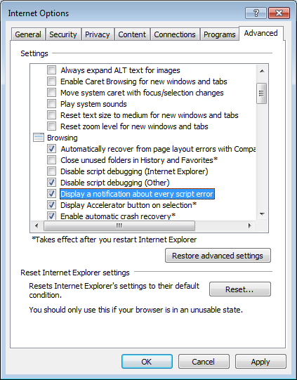
Debugging JavaScript in IE 9

Slide 74
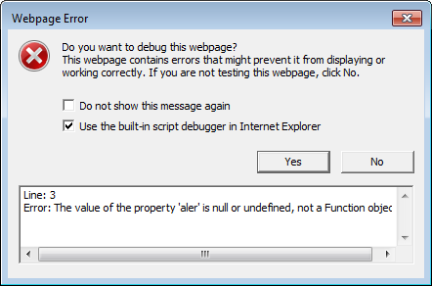
Debugging JavaScript in IE 9
When you open a file through IE that has errors in its JavaScript code the following message will then be displayed.
Make sure the check box “Use the built-in script debugger in IE” is checked and click on Yes to launch the Debugger Tool. (Subsequently this can also be accessed by pressing F12 or choose Tools | F12 Developer)

